Slide 1

EEG-based Emotion Classification: Advanced Signal Processing & Machine Learning
Team Tech Envies
Decoding human emotions from EEG signals
Notes:
1

Slide 2
Dataset Overview: DREAMER
DREAMER
└── Data
└── Subject
├── Age
├── Gender
├── EEG
│ └── Video
│ ├── baseline
│ └── stimuli
├── ECG
├── ScoreValence
├── ScoreArousal
└── ScoreDominance
Dataset Name
DREAMER: A multi-modal database for emotion recognition.
Signals Used
EEG (primary)
ECG (optional for multimodal fusion)
Sampling Frequency
128 Hz, ensuring high temporal resolution.
Emotion Labels
Valence (pleasure), Arousal (excitement), Dominance (control).
Notes:
2

Slide 3
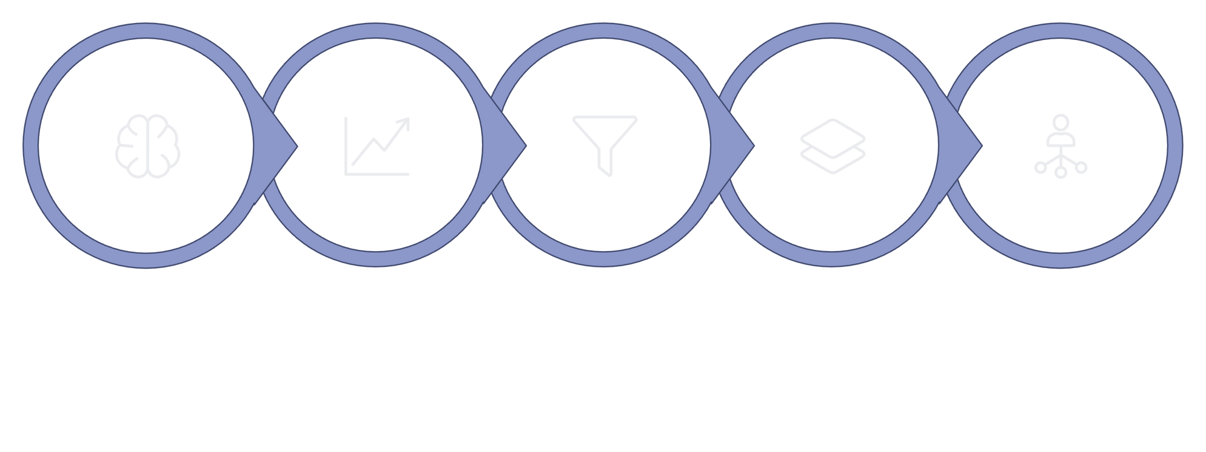





End-to-End System Pipeline
Raw EEG
Exploratory
Preprocess
Features
Classify
Our modular pipeline ensures robust and reproducible emotion classification.
Notes:
3

Slide 4
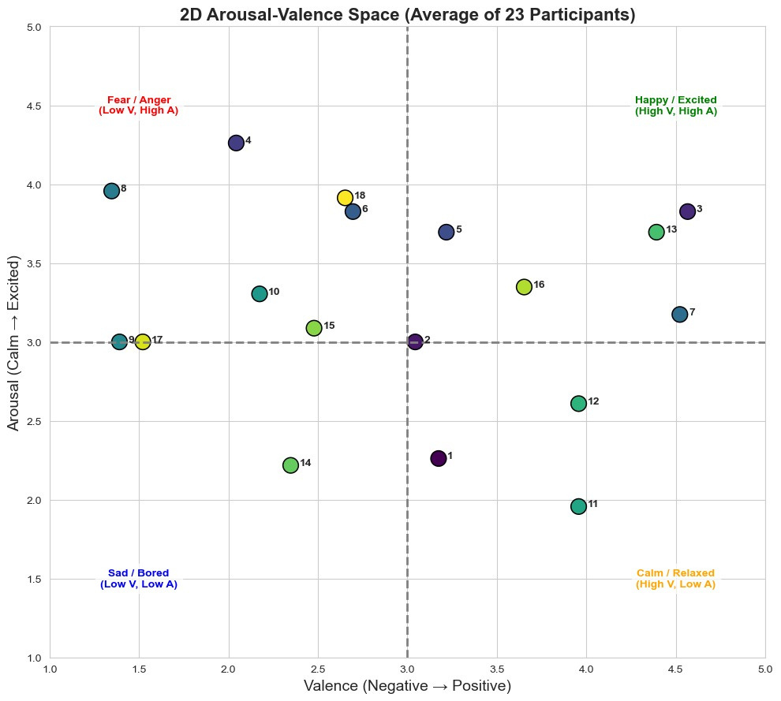
Phase 1: Exploratory Data Analysis (EDA)
2D Arousal–Valence Space
Visualizing emotional distribution to understand participant responses.
The emotional structure is well-defined, making the dataset suitable for EEG-based affect recognition

Slide 5
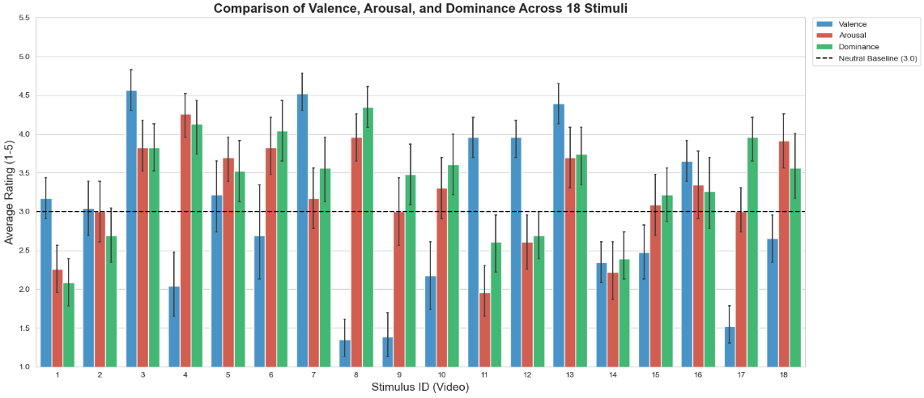
Valence, Arousal, Dominance
Bar plots illustrate the distribution of subjective ratings for each dimension.
This diversity justifies learning stimulus-dependent EEG patterns and motivates supervised classification
Notes:
5

Slide 6
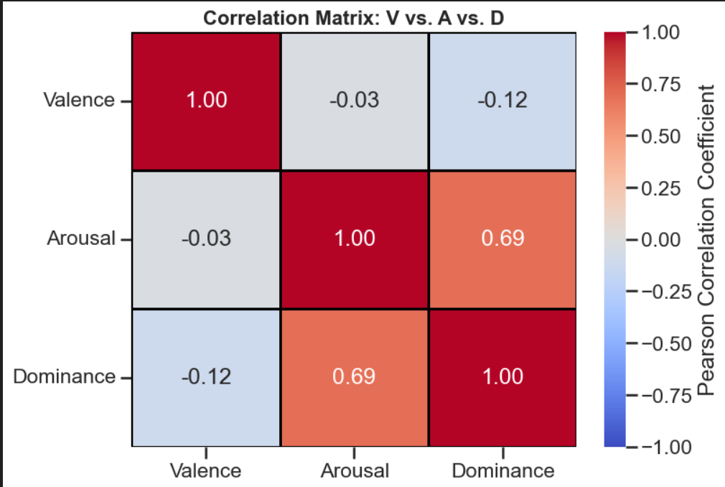
VAD Correlation Analysis
Investigating inter-dependencies between emotional dimensions.
Emotional dimensions interact in complex ways, which justifies advanced signal processing and machine-learning-based modeling

Slide 7
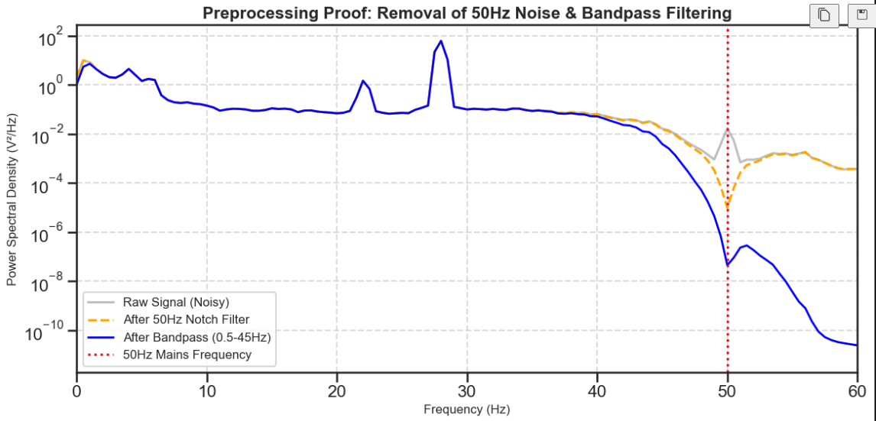
Phase 2: EEG Preprocessing & Signal Cleaning
STEP 1 : Proof of Filtering
50 Hz notch (trap) filter to remove power-line noise and Band-pass filtering from 0.5 Hz to 45 Hz

Slide 8
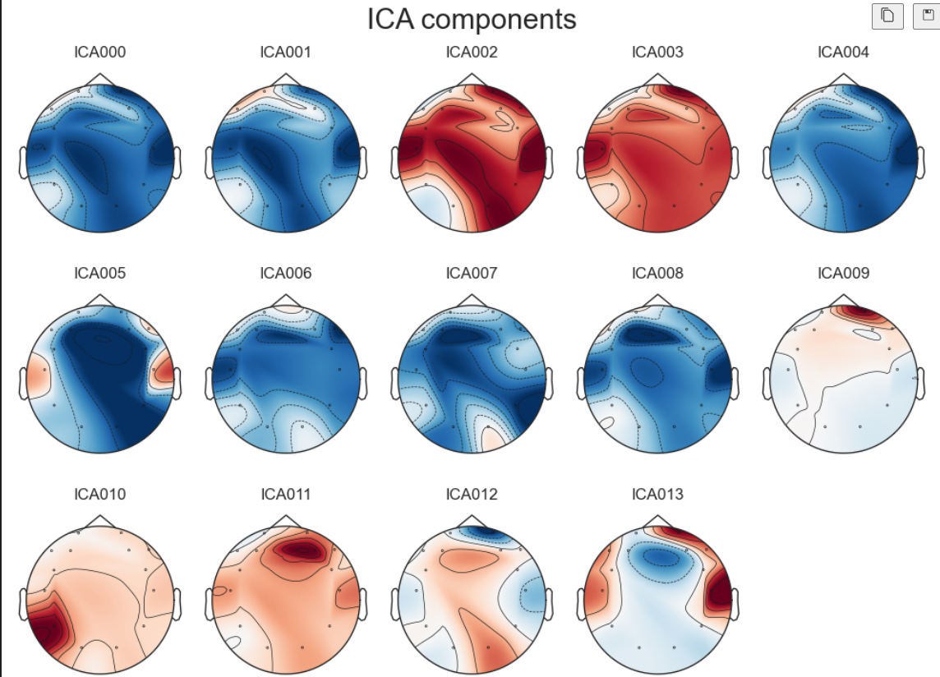
STEP 2: Independent Component Analysis (ICA)
Decomposes EEG signals into statistically independent components representing brain activity and artifacts.
Eye blink artifacts are identified by strong frontal activation and large low-frequency amplitudes.

Slide 9
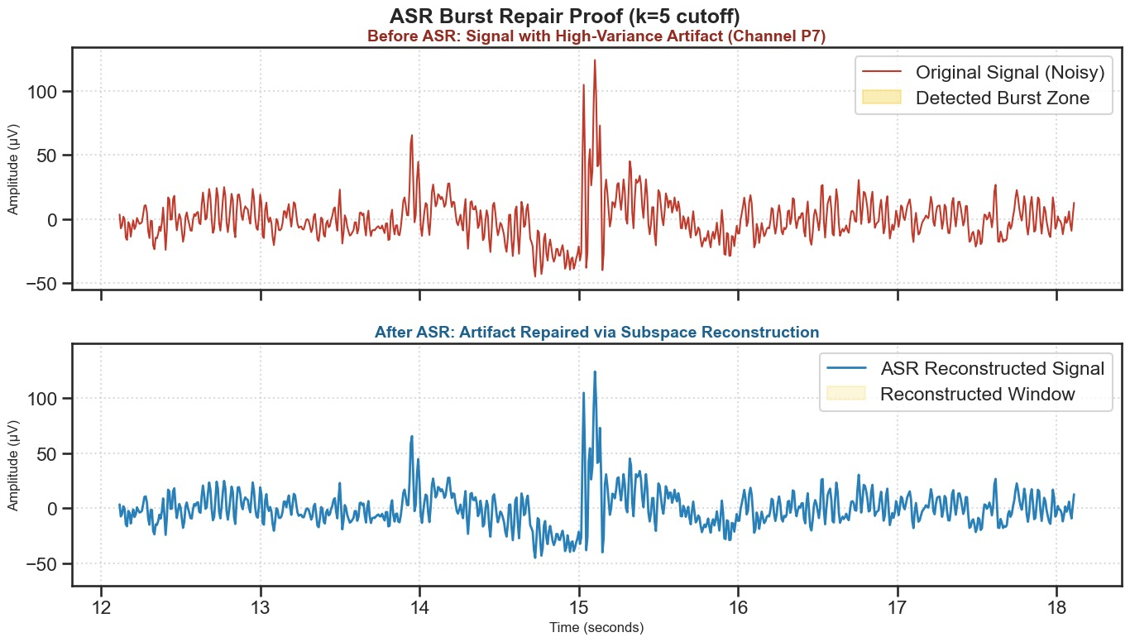
STEP 3: Artefact Subspace Reconstruction (ASR)
ASR detects short-duration, high-amplitude artifacts in EEG signals that are not removed by filtering or ICA, such as sudden muscle bursts or motion noise.
It reconstructs corrupted EEG segments by projecting them back into a clean signal subspace learned from artifact-free data, instead of discarding the data.
ASR helps preserve neural information while improving signal quality, making it especially effective for real-world and dynamic EEG recordings.

Slide 10
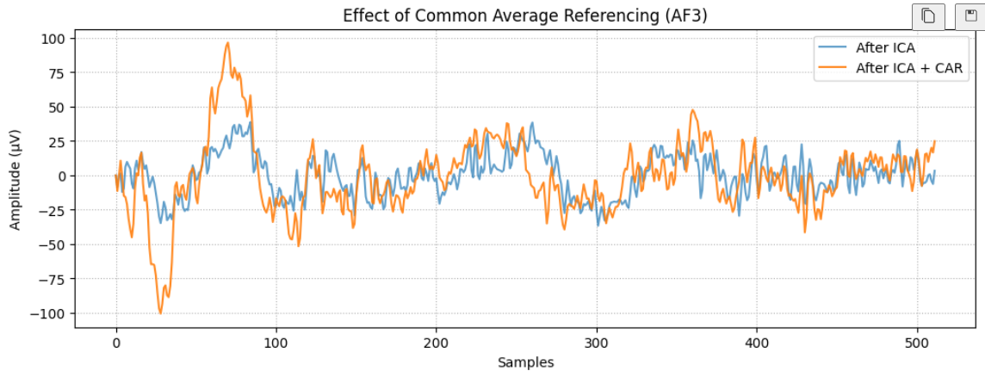
STEP 4: Common Average Referencing (CAR)
EEG measures voltage differences, not absolute voltage; referencing is essential to obtain meaningful and comparable signals across electrodes.
Common Average Referencing reduces common-mode noise shared across channels, such as environmental and system noise.
CAR improves spatial resolution and signal interpretability, making neural activity patterns more reliable for feature extraction and classification.

Slide 11
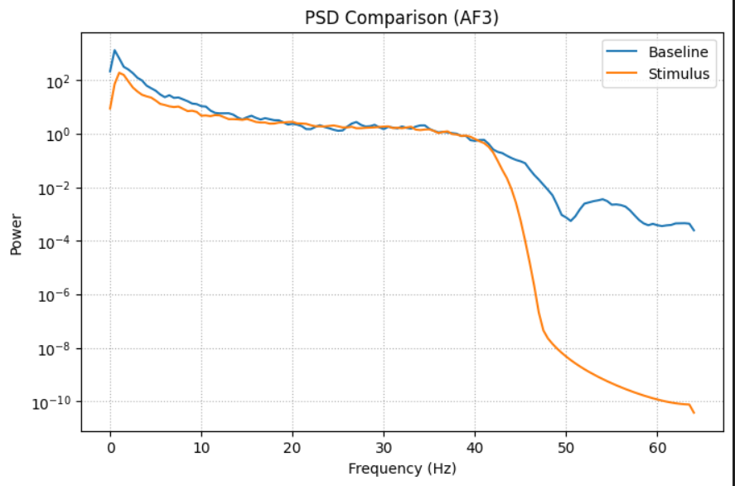
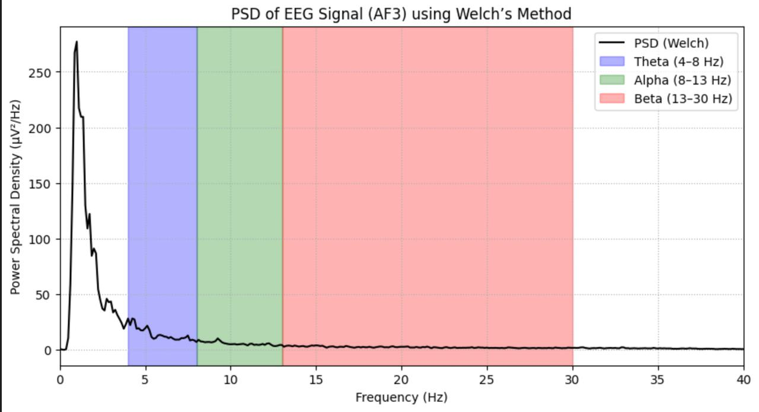
Phase 3: Feature Extraction & Signal-Level Reasoning
Baseline and Trial Segmentation
Stimulus EEG (after ICA + CAR) Shape: (25472, 14) Channels: 14 Baseline EEG (raw) Shape: (7808, 14) Channels: 14 ✔ Baseline and stimulus channels match
Compute Power Spectral Density (PSD)
PSD Baseline shape : (14, 129) PSD Stimulus shape : (14, 129) Frequency range: 0.0 Hz to 64.0 Hz
Band-specific PSD features for each electrode:
THETA CORRECTED FEATURES Shape: (14,)
Mean value: -115.53427090999149
ALPHA CORRECTED FEATURES Shape: (14,)
Mean value: -41.95787717650894
BETA CORRECTED FEATURES Shape: (14,)
Mean value: -7.077240092751699

Slide 12
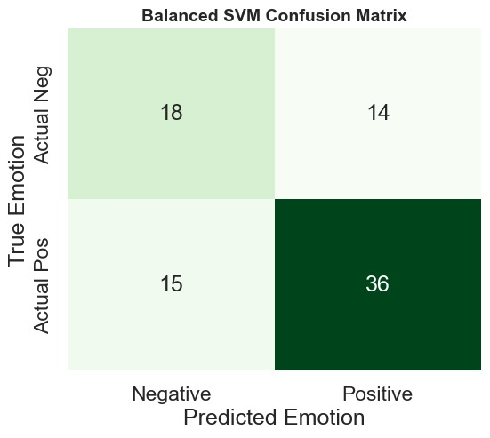
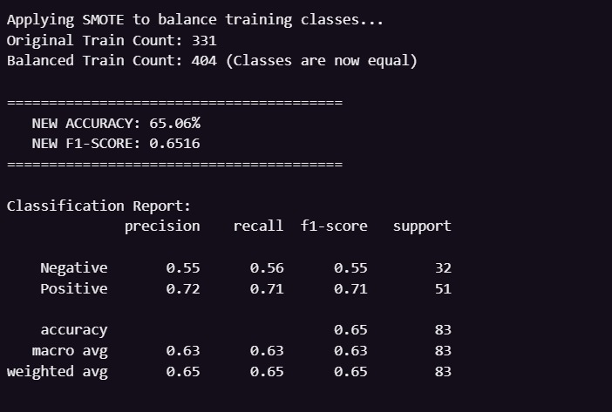
Phase 4: Affect Recognition & Evaluation
Achieved an accuracy of 65.06% and F1 –score of 0.6516

Slide 13
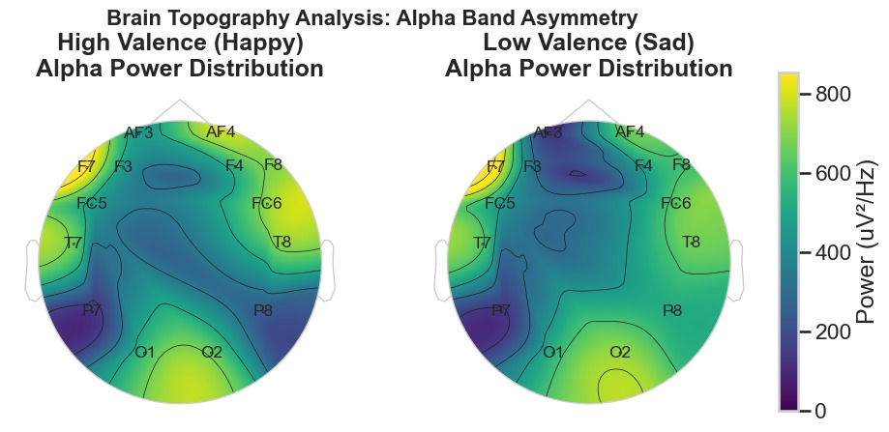
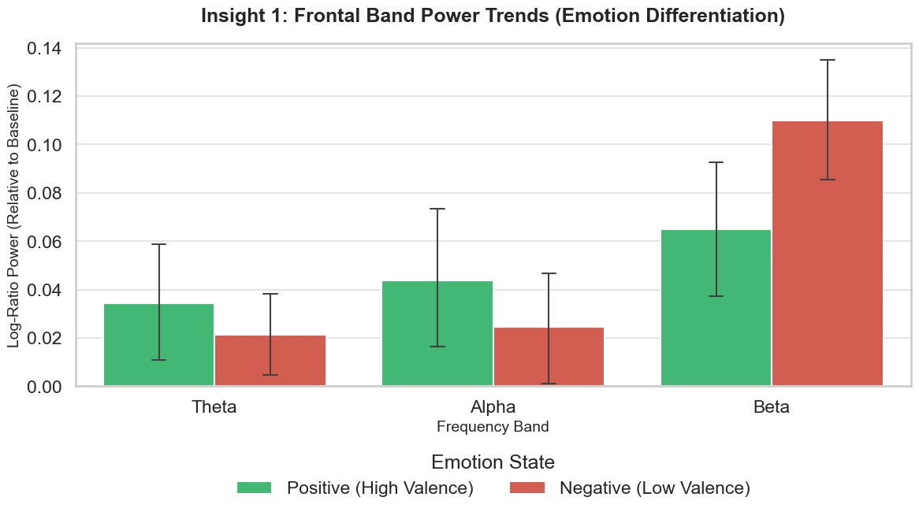
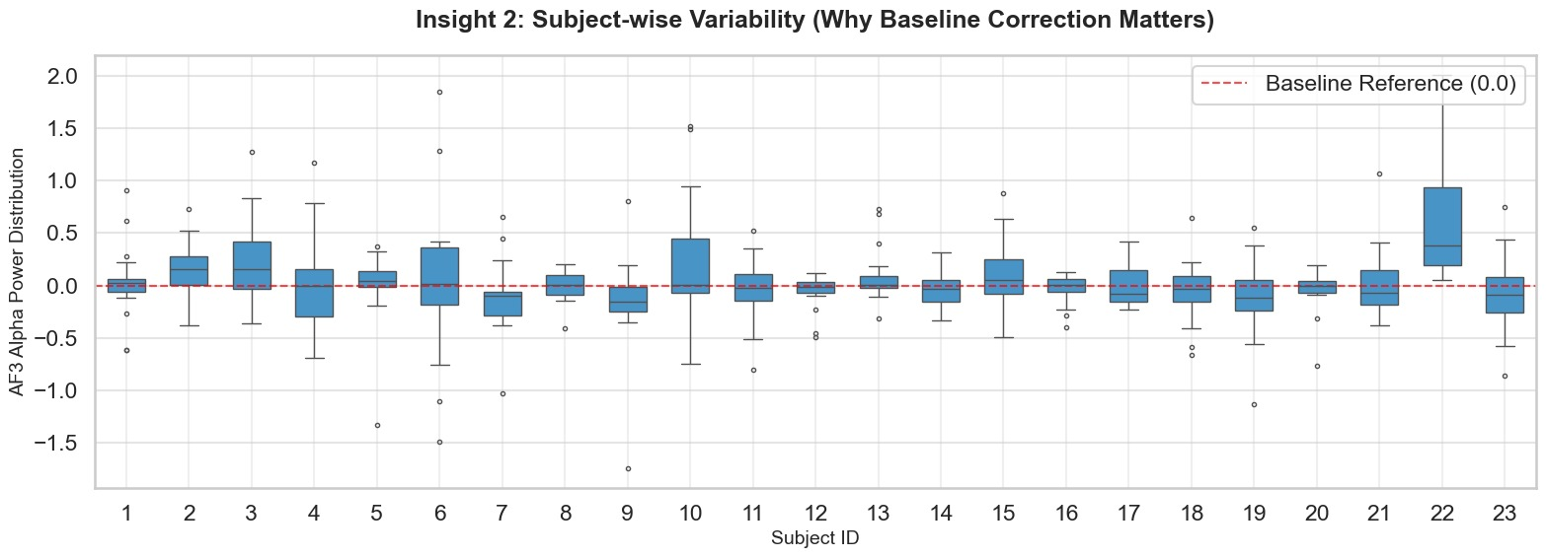
Phase 5:

Slide 14
Limitations
Subject Variability:
EEG signals exhibit strong inter-subject variability, making it difficult to build a fully generalized emotion recognition model.
Limited Spatial Resolution:
The dataset uses a limited number of EEG channels, restricting fine-grained spatial analysis of brain activity.
Noise Sensitivity:
Despite advanced preprocessing (ICA, ASR), residual physiological artifacts may still influence extracted features.
Binary Emotion Simplification:
Converting continuous Valence–Arousal–Dominance ratings into binary classes may lead to loss of nuanced emotional information.
Class Imbalance:
Uneven distribution between high and low emotional states can bias classification performance metrics.

Slide 15
Future Scope
Multimodal Fusion:
Integrate ECG and other physiological signals with EEG to improve robustness and emotion classification accuracy.
Advanced Deep Learning Models:
Explore CNNs, RNNs, or Transformer-based architectures for learning temporal and spatial EEG representations.
Subject-Adaptive Learning:
Implement personalization techniques or transfer learning to reduce inter-subject variability effects.
Real-Time Emotion Recognition:
Extend the pipeline for online, real-time affect recognition applications in HCI and mental health monitoring.
Fine-Grained Emotion Modeling:
Move beyond binary classification to multi-class or continuous emotion prediction in the VAD space.

